Slide 1
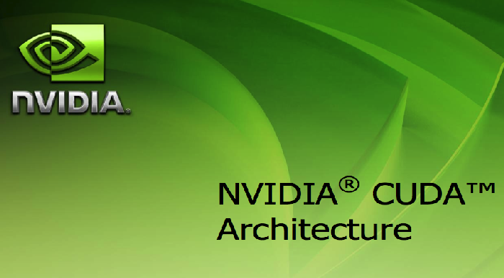

Slide 2
History
GPGPU was far from easy , even for those who knew graphics programming languages such as OpenGL.
Developers had to map scientific calculations onto problems that could be represented by triangles and polygons.

Slide 3
What is CUDA ?
Computed Unified Device Architecture
CUDA is a parallel computing platform and programming model invented by NVIDIA.
Programming model to extend c with data-parallel constructs
By harnessing power of GPU it allows user to increase computing performance drastically

Slide 4
CUDA offers the CUDA Toolkit, which provides development environment for C and C++
Contents : compiler, math libraries and api ,tools for debugging and optimizing.
CUDA API extends the C programming language. It runs on thousands of threads and is a scalable model.
Nvidia nopiler hadles 2 phases of running code on host(cpu ) and device(gpu). Lost of switching is done due to use of both cpu and gpu.

Slide 5
What is GPU ?
A graphics processing unit (GPU), also occasionally called visual processing unit (VPU)
It is a specialized electronic circuit designed to rapidly manipulate and alter memory to accelerate the creation of images in a frame buffer intended for output to a display.
It can also be used for other computations.

Slide 6
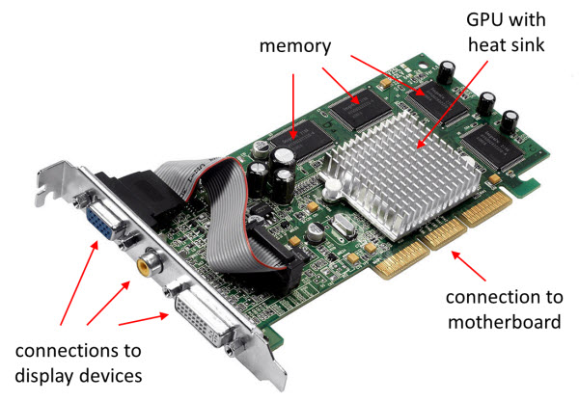

Slide 7
GPU computing
Applications run the sequential part of their workload on the CPU while accelerating parallel processing on the GPU. This is called GPU computing.
CPU executes single threaded codes while GPU executes a high number of threads in parallel, while using CUDA.
It is hybrid or heterogeneous computing since it involves use of CPU and GPU.

Slide 8
CPU vs GPU

Slide 9
CPU is composed of a only few cores with lots of cache memory that can handle a few software threads at a time, but GPU is composed of hundreds of cores that can handle thousands of threads simultaneously.
The ability of a GPU with 100+ cores to process thousands of threads can accelerate some software by 100x over a CPU alone.
hence GPU is more power- and cost-efficient than a CPU

Slide 10
Working steps
The execution starts with host (CPU) execution. When a kernel function is invoked, the execution is moved to the device, where a large number of threads are generated. The threads form a grid.
When all the threads of a kernel complete their execution, the corresponding grid terminates, the execution continues on the host until another kernel is invoked.

Slide 11
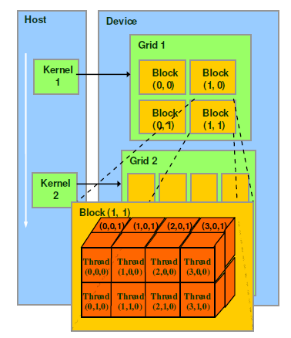

Slide 12
Advantages of CUDA
Flexibility to the vendor.
Hides latency and helps maximize the GPU utilization.
Transparent for the programmer.
Automatic thread management.
Limited synchronization between threads is provided.
Dead-locks are avoided.

